Slide 1
Data 606 Presentation
Chad Bailey Problem 9.3

Slide 2
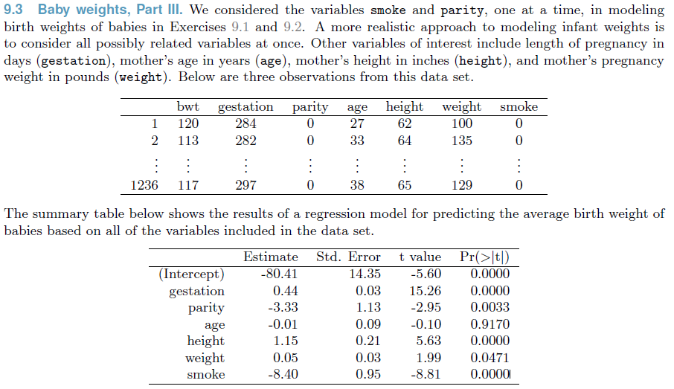
Problem Introduction

Slide 3
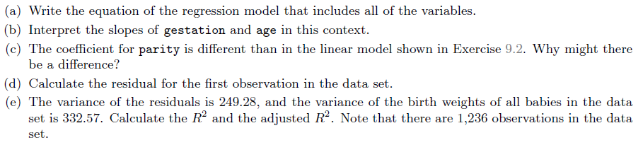
Problem Parts

Slide 4
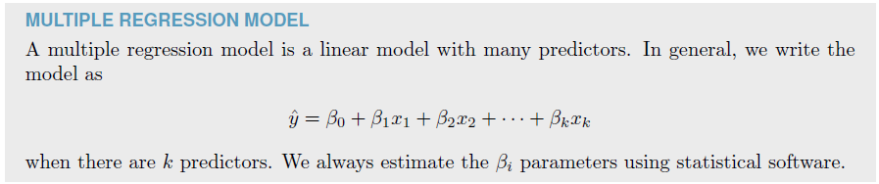
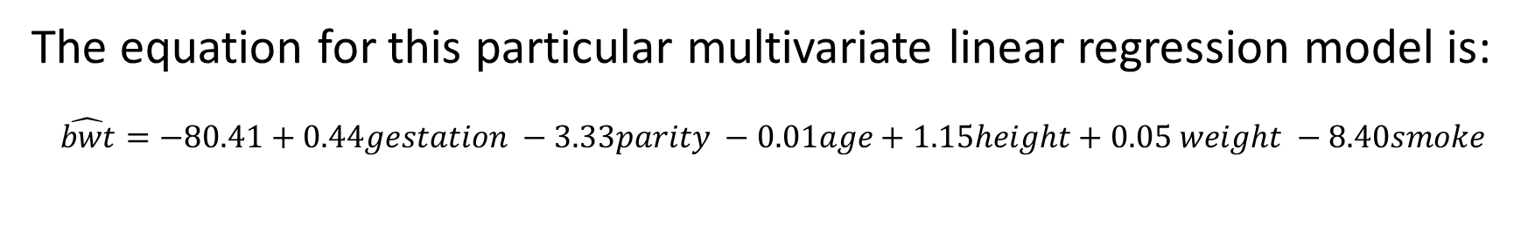
Part A: Model Equation
(a) Write the equation of the regression model.
The equation for this particular multivariate linear regression model is:
$$\hat{bwt}=−80.41+0.44gestation −3.33parity −0.01age+1.15height+0.05 weight −8.40smoke$$

Slide 5
Part B: Interpreting Select Coefficients
(b) Interpret the slopes of gestation and age in this context.
The slope for gestation is 0.44 and can be interpreted that for every additional day in gestation the model predicts the baby’s weight to increase in 0.44 ounces
The slope for age is -0.01 and can be interpreted that for every additional year in the mother’s age during pregnancy the model predicts the baby’s weight to decrease by 0.01 ounces.

Slide 6
Part C: Model Differences
(c) The coefficient for parity is different than in the linear model shown in Exercise 9.2. Why might there be a difference?
The model in Exercise 9.2 was a univariate linear model based solely on parity. The model here in Exercise 9.3 is a multivariate linear model where parity is one of six predictive variables.
The difference in the coefficient for parity is difference in the multivariate model because the “best fit” regression is being based on all six predictive variables simultaneously. This means that the fit to any one variable will be adjusted particularly if there are cross effects between variables.

Slide 7
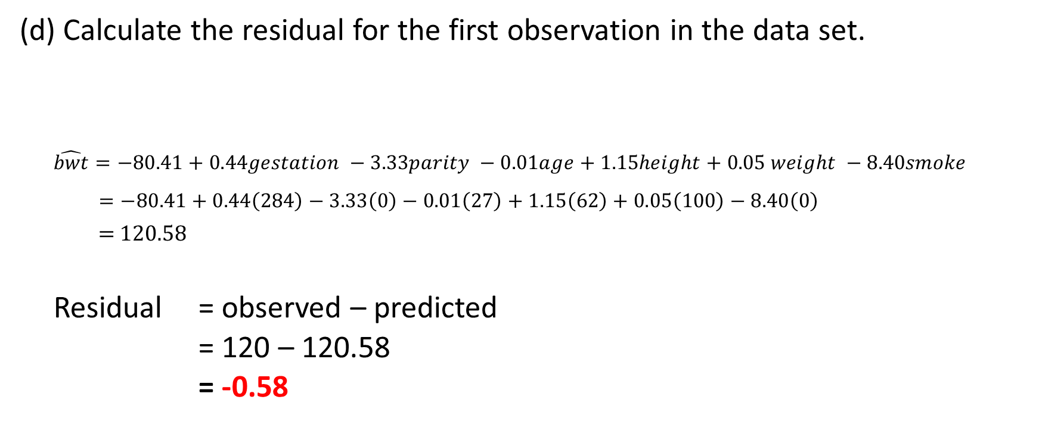
Part D: Sample Residual
(d) Calculate the residual for the first observation in the data set.
$$\hat{bwt}=−80.41+0.44gestation −3.33parity −0.01age+1.15height+0.05 weight −8.40smoke$$
$=−80.41+0.44\left(284\right)−3.33\left(0\right)−0.01\left(27\right)+1.15\left(62\right)+0.05\left(100\right)−8.40\left(0\right)$
= 120.58
Residual = observed – predicted
= 120 – 120.58
= -0.58

Slide 8
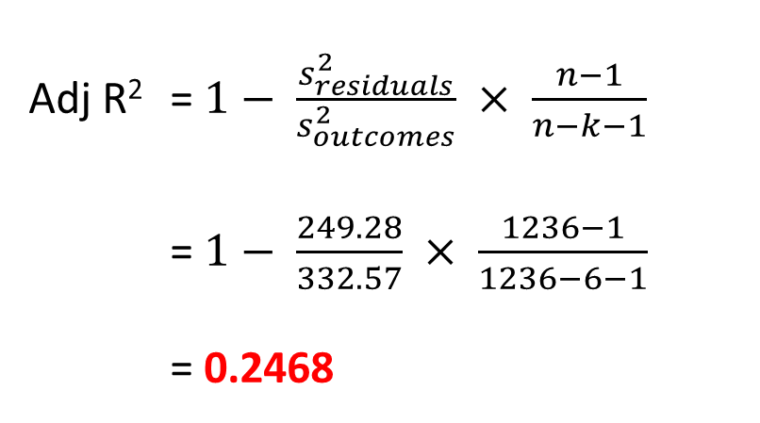
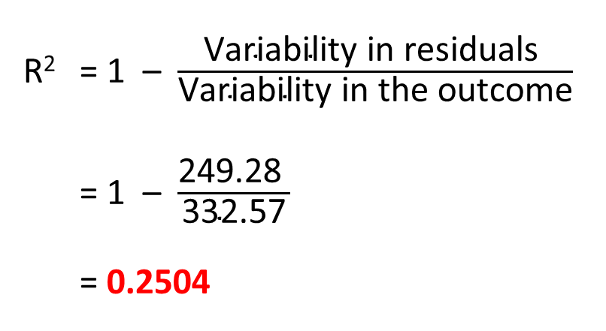
Part E: R Squared & Adjusted R Squared
(e) The variance of the residuals is 249.28, and the variance of the birth weights of all babies in the data set is 332.57. Calculate the R² and the adjusted R². Note that there are 1,236 observations in the data set.
R² = 1 – $\frac{\text{Var}\text{iability} \text{in} \text{residuals} }{\text{Var}\text{iability} \text{in} \text{the} \text{outcome}}$
= 1 – $\frac{\text{249.28 }}{\text{3}\text{32.57}}$
= 0.2504
Adj R² = $1− \frac{s_{residuals}^{2}}{s_{outcomes}^{2}} × \frac{n−1}{n−k−1}$
= $1− \frac{249.28}{332.57} × \frac{1236−1}{1236−6−1}$
= 0.2468

